Slide 1

Recurrent Neural Networks for Crude Oil Prices
AVANTIKA YELLAPANTULA

Slide 2

FORECASTING
Crude Oil is a significant part of the global economy.
Many people are interested in predicting or forecasting crude oil both to make profit and to use crude oil as a market indicator.
How should we forecast crude oil prices?
Since crude oil is a time series, we can first take a look at the data:

Slide 3
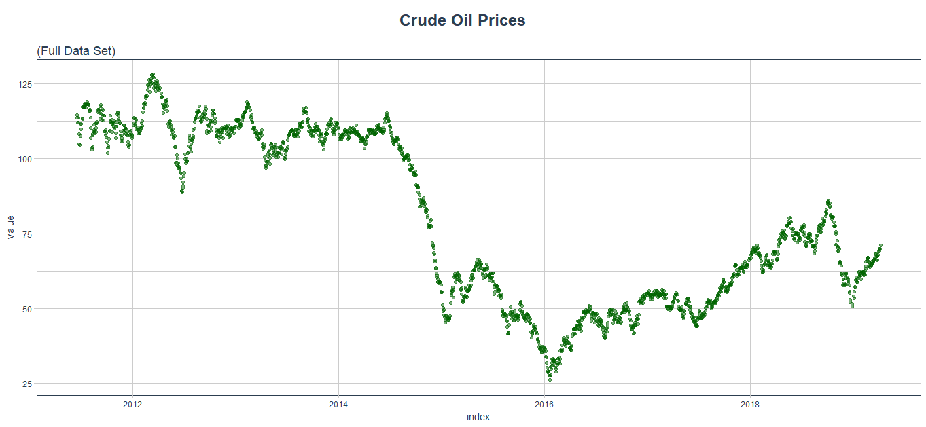
FORECASTING
Notes:
Discuss:
Volatility of the graph
Dip between 2015-2017
Causes are many factors
Venezuela - oil backed loans

Slide 4
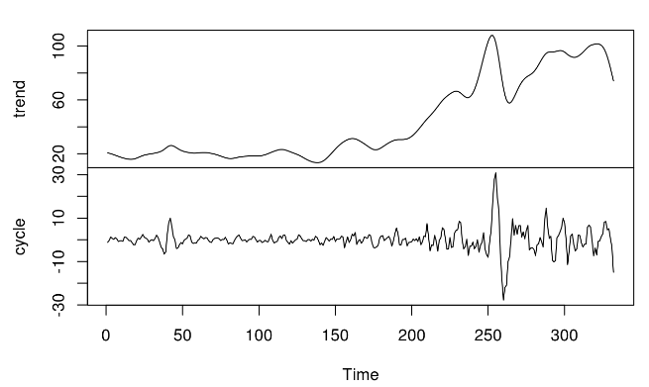
FORECASTING
In order to understand the data a little better, we can decompose it to find the trend and cycle of the data:
Clearly, we see a trend and a cycle. In order to eliminate the high fluctuation we see, we can use log transformations and take a difference of the series

Slide 5
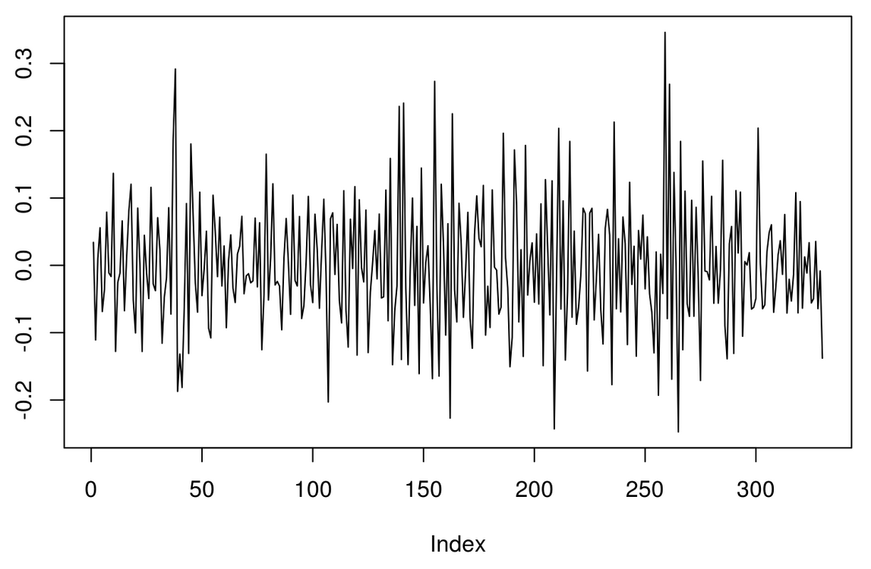
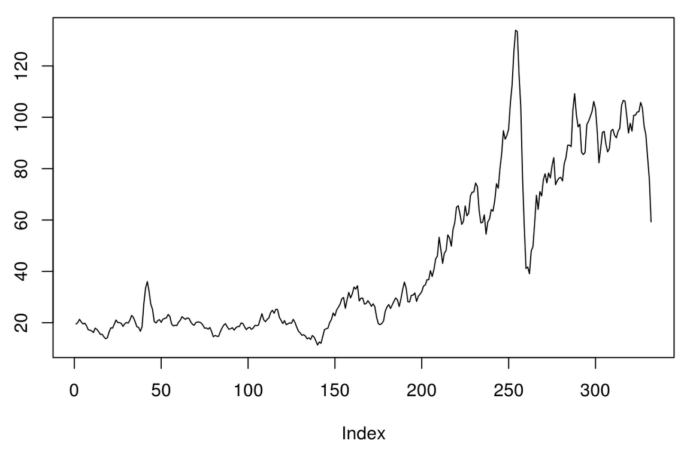
After Log and Difference
After only log transformation

Slide 6
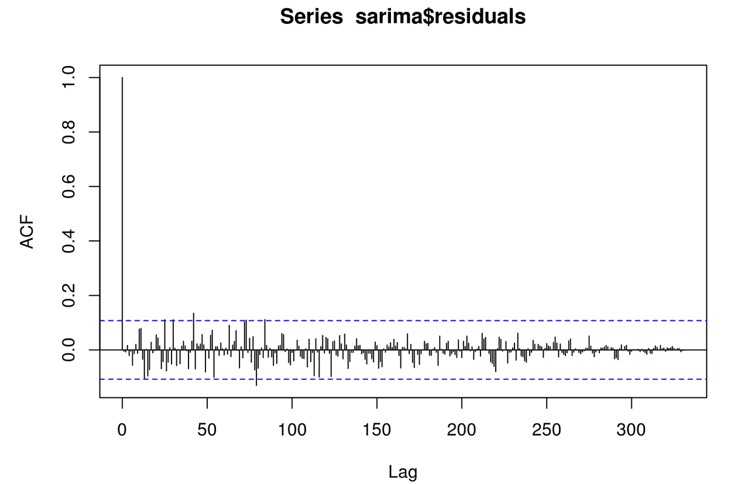
After applying an ARMA model to the data

Slide 7
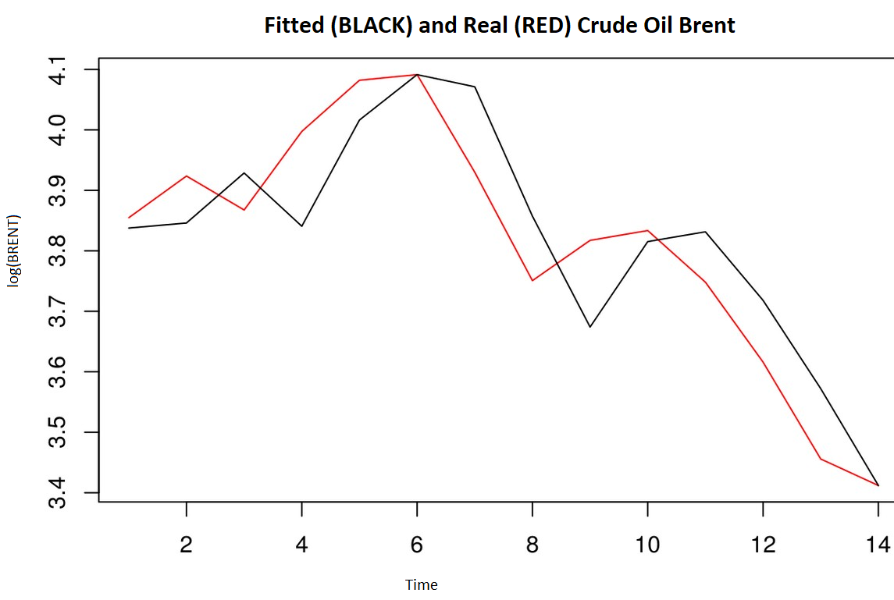
FORECASTING
There are some clear problems with this model:
The next step is to take a more involved approach

Slide 8
NEURAL NETWORKS
Neural networks are a set of algorithms, modeled loosely after the human brain, that are designed to recognize patterns.
They interpret sensory data through a kind of machine perception, labeling or clustering raw input.
They help us cluster and classify

Slide 9
RECURRENT NEURAL NETWORKS
It’s unclear how a traditional neural network could use its reasoning about previous events in the film to inform later ones.
Recurrent neural networks address this issue. They are networks with loops in them, allowing information to persist.

Slide 10
IMPLEMENTATION PROCESS
STEP 1: Exploratory Analysis
Returning to the data we see that there is a cyclical trend of the data. Because of this sequential data, we use recurrent neural networks to forecast.

Slide 11
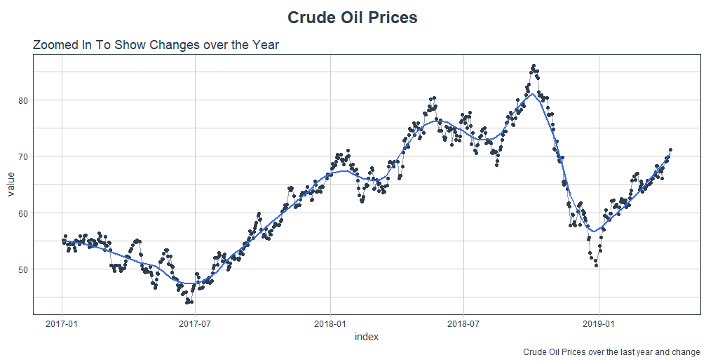
IMPLEMENTATION PROCESS

Slide 12
IMPLEMENTATION PROCESS
STEP 2: Cross-Validation Strategy
Strategy to test the model, split the model into several sample sub-sets and performing a training/testing process
In essence, we’re creatively dealing with the fact that there’s no future test data available by creating multiple synthetic “futures” - a process often, esp. in finance, called “backtesting”

Slide 13
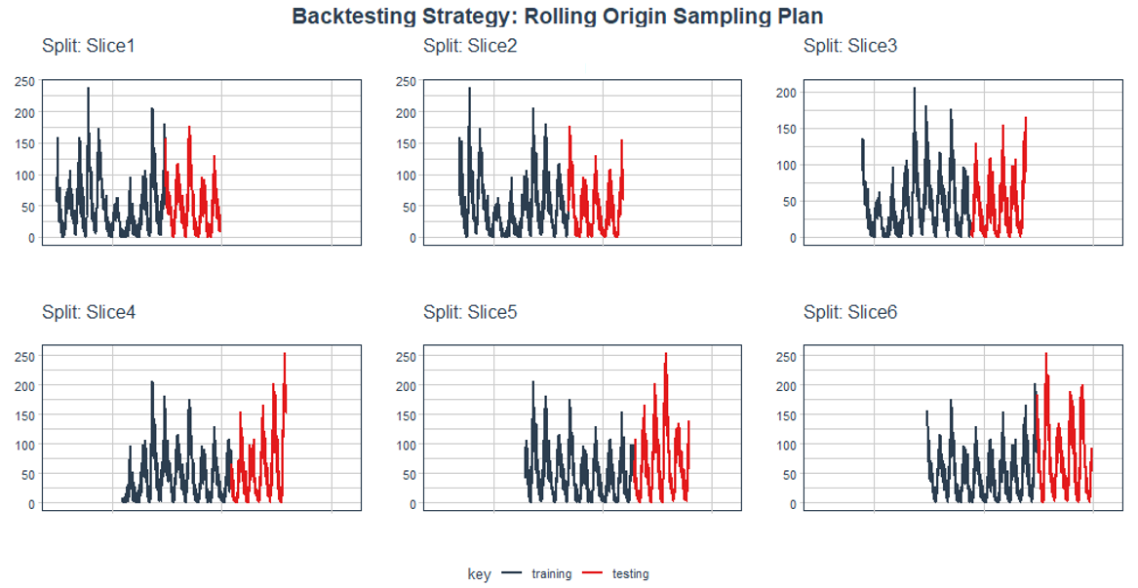
IMPLEMENTATION PROCESS

Slide 14
IMPLEMENTATION PROCESS
STEP 3: Creating the LSTM model
First develop the model on a single slice. Then repeat the model (as a function) on all the slices
How are the predictions from the LSTM model different from the time series model from earlier

Slide 15
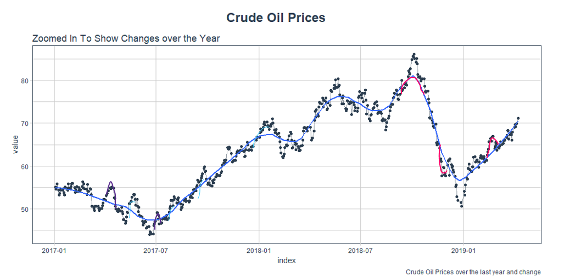
OUTPUT

Slide 16
CODE
Code for the simple ARMA Time Series Model: https://github.com/avYell/brent_crudeoil/blob/master/simple_time_series_brent.R
Code for the LSTM model:
https://github.com/avYell/brent_crudeoil/blob/master/new_lstm.R

Slide 17

QUESTIONS

